Slide 1
NEW ACH CHARITY PAYMENT PROCESS
DAN FAULKNER
EXECUTIVE DIRECTOR
7 JUNE 2025

Slide 2
OVERVIEW
TRANSITION FROM PAPER CHECKS TO ON-LINE PAYMENT OF CHARITY DISTRIBUTION FROM GAMING
ONE WAY ONLY: FROM FIELD AGENT GAMING ACCOUNT TO VFWOC GENERAL FUND
LEVERAGES 5/3RD “BILLER DIRECT” PROCESS
PAYMENT TEMPLATE “MODIFIED” FOR VFWOC NEEDS
TEST SITE AVAILABLE FOR ON-LINE PRACTICAL LEARNING/TRAINING

Slide 3
BILL PAY CONCEPT VIDEO

Slide 4
REVIEW OF TEMPLATES

Slide 5
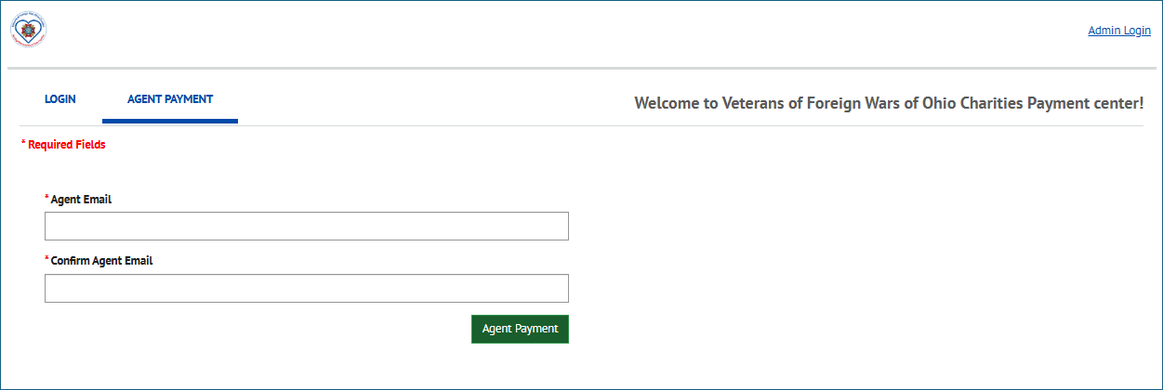

Slide 6
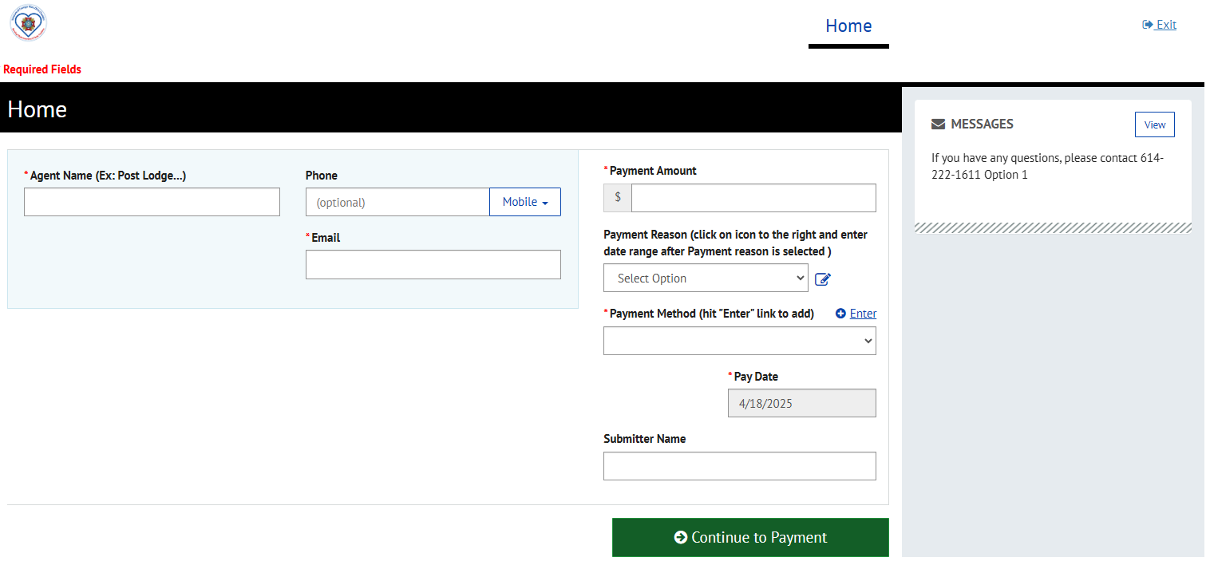
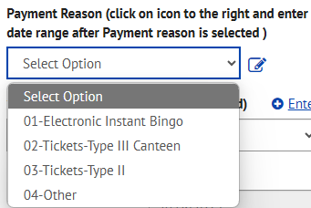
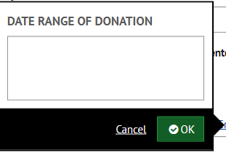

Slide 7
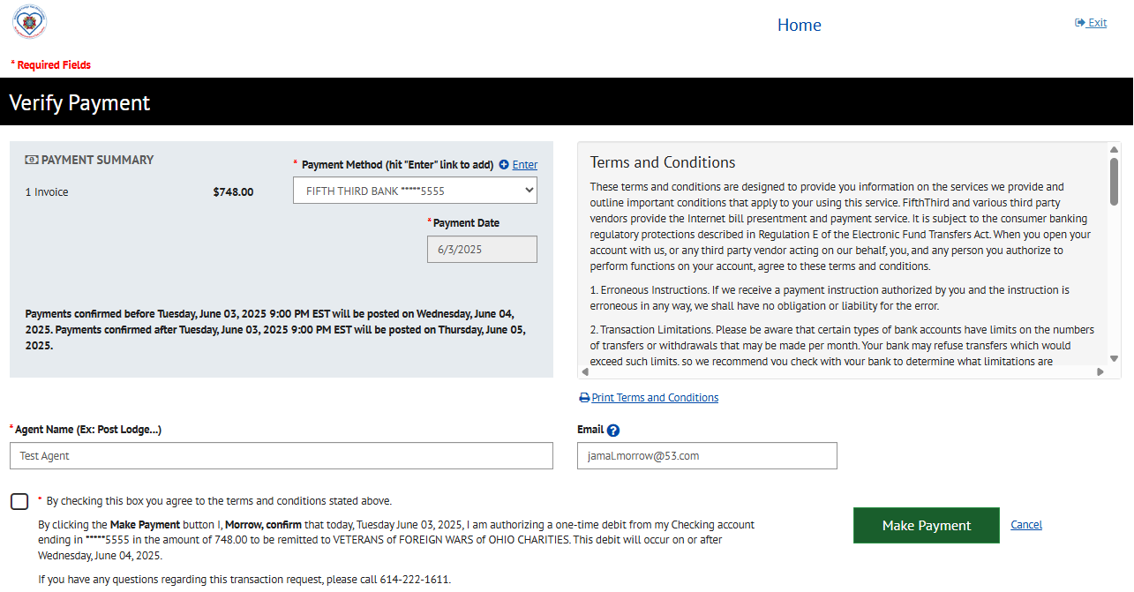

Slide 8
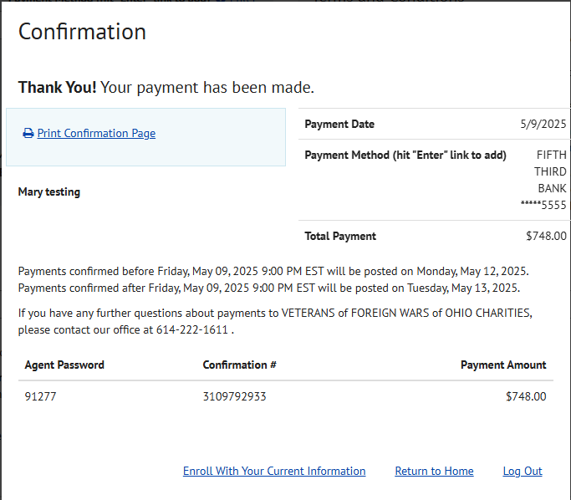

Slide 9
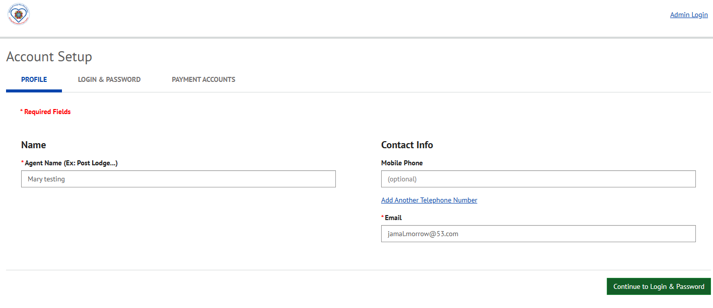

Slide 10
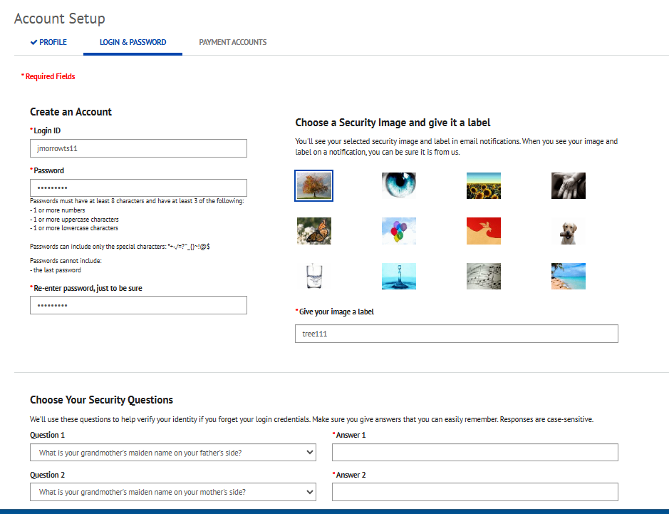

Slide 11
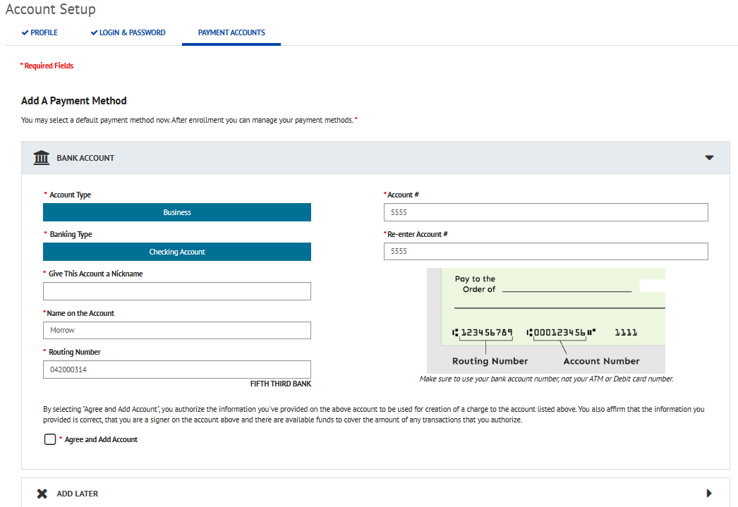

Slide 12
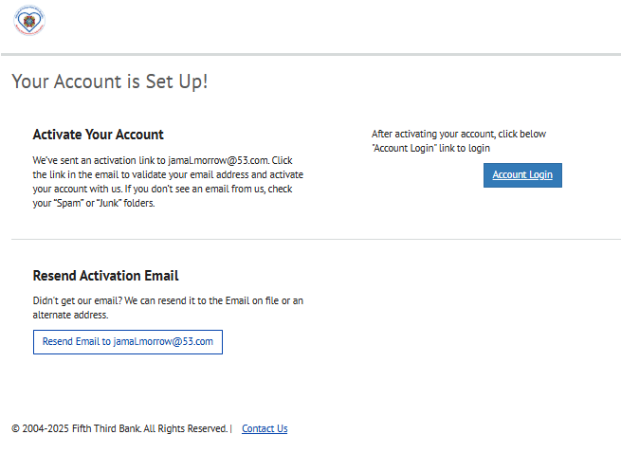

Slide 13
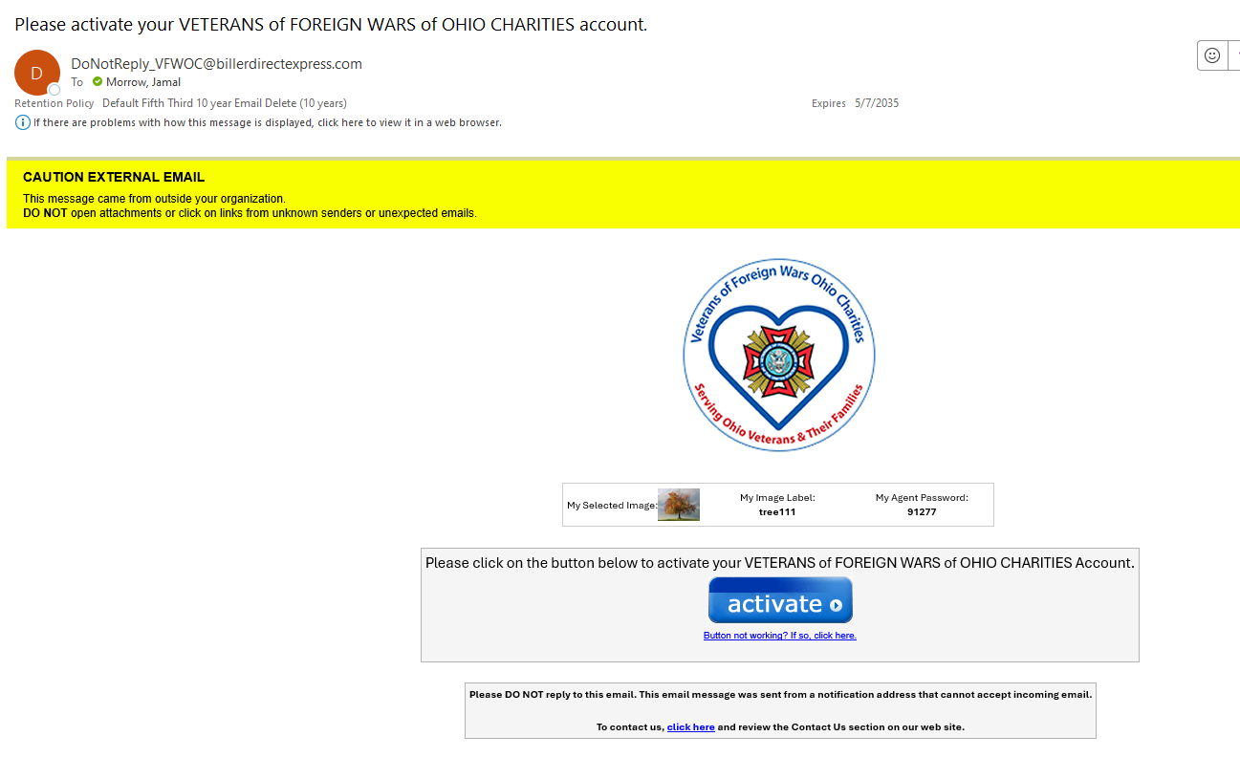

Slide 15
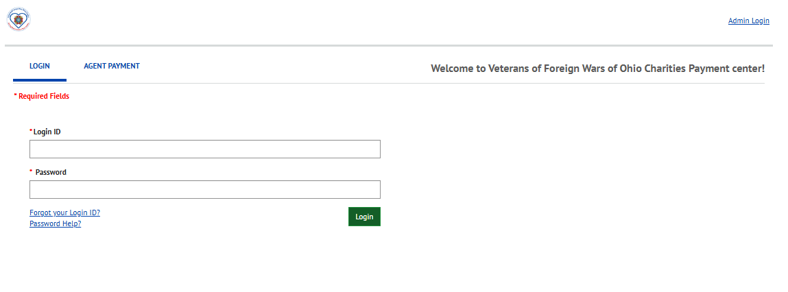

Slide 16
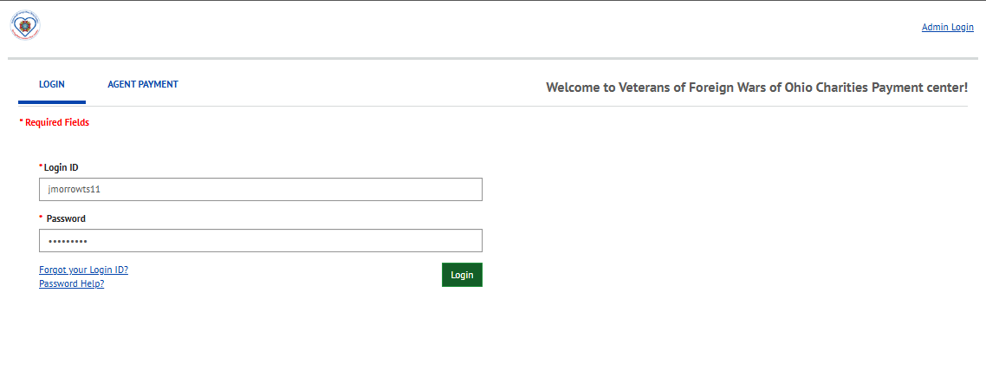

Slide 17
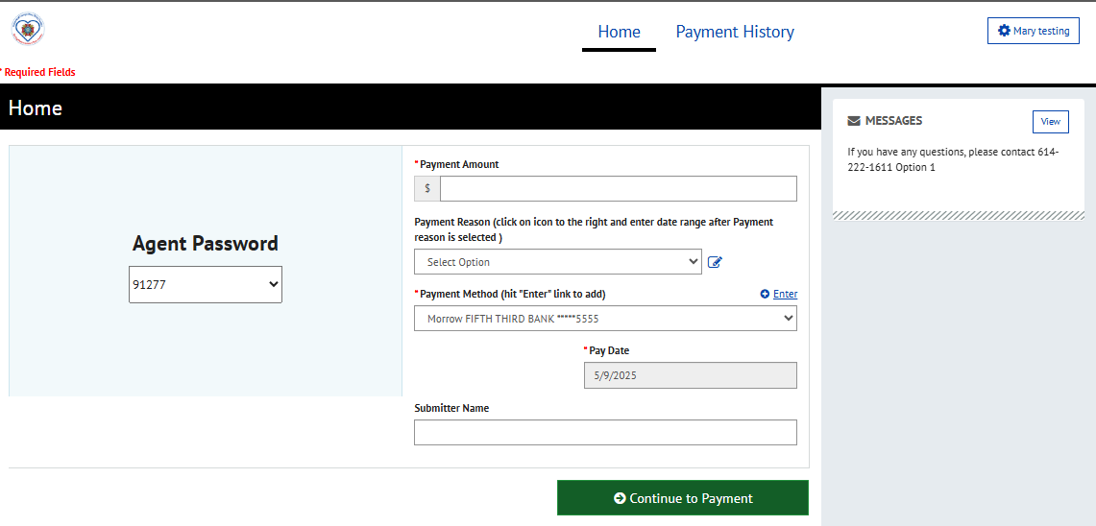

Slide 18
WHATS NEXT?
NEED ONE PERSON FROM EACH DISTRICT TO BE PART OF INITIAL BETA TEST. WILL NEED NAME, CELL PHONE NUMBER (TXT CAPABLE) AND ORGANIZATIONAL E-MAIL ADDRESS. REQUIRED TO BE ADDED TO 5/3rd TEST SITE.
SEND E-MAIL TO VFWOC@VFWOC.COM PUT “BETA” IN SUBJECT LINE
AFTER BETA TESTING IS COMPLETE, AND LESSONS LEARNED INCORPORATED – O/A 1 JUL, WILL START LIVE PAYMENTS WITH INITIAL 12 MEMBER TEST GROUP
ONCE INITIAL LIVE PAYMENTS ARE COMPLETE, O/A 1 AUG WE CAN TRANSITION TO OTHER FIELD AGENTS

